Slide 1
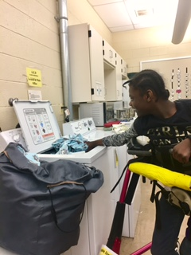
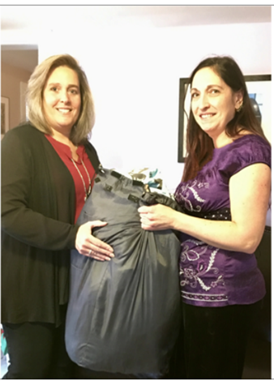
The students at the Academy Learning Center have embarked upon a new vocational education experience that is designed to build upon the many skills they have been refining over the past year. There are many students who have greatly benefitted from the training and sense of responsibility they have gained from the towel laundering program at ALC. Established in 2016, this program was designed to teach students of all ages and abilities the skills utilized when participating in hand towel collection, laundering, drying, sorting, folding, and delivery. The competences gained when working through this program include an improved ability to: participate in social interactions (for some including the use of a voice-output device), follow directions, collect items in an organized approach, utilize a wash machine, operate a dryer, sort, fold, and deliver items to each owner. The “Loads of Lessons” laundry program will allow our students to build-upon the diverse skills they have gained from the existing program, while allowing them to serve their community in a special way. Established in 1994 by Stephanie H. Lipnicki, the Natural Alternatives Center for Wellness offers the following services: Acupuncture, Moxabustion, Chinese Herbal Therapy, Gua Sha and Tui Na Massage, Cupping, Therapeutic massage and more. The benefits include relaxation, relief of mental and physical fatigue, and improved circulation to name a few. The Sanctuary at Natural Alternatives additionally offers Yoga classes and seminars to educate individuals interested in these forms of treatment. While the goal of this center is to help individuals feel better, these service offerings aim to help those on their path to wellness to also live their lives as wholly as possible. This theme lends itself nicely to the desire that we share at the Academy Learning Center to also allow our students to live their lives as fully as possible while engaged in purposeful activity. Therefore, occupational therapist, Lynette M. Huth, OTR/L has developed a program along with health care provider Stephanie H. Lipnicki, which allows our students to launder and prepare the numerous towels and linens utilized at the Natural Alternatives Center for Wellness on a weekly basis. The creation of our relationship with this remarkable business will allow our students to continually practice the skill set they will acquire here at the Academy Learning Center; while generalizing their skills and branching-out into their local community.
Left - ALC student Ny’aja Williams participating in the “Loads of Lessons” laundry program. Right– Lynette M. Huth, OTR/L (Occupational Therapist at ALC) returns clean laundry to Stephanie H. Lipnicki of the Natural Alternatives Center for Wellness in Allentown

