Slide 1
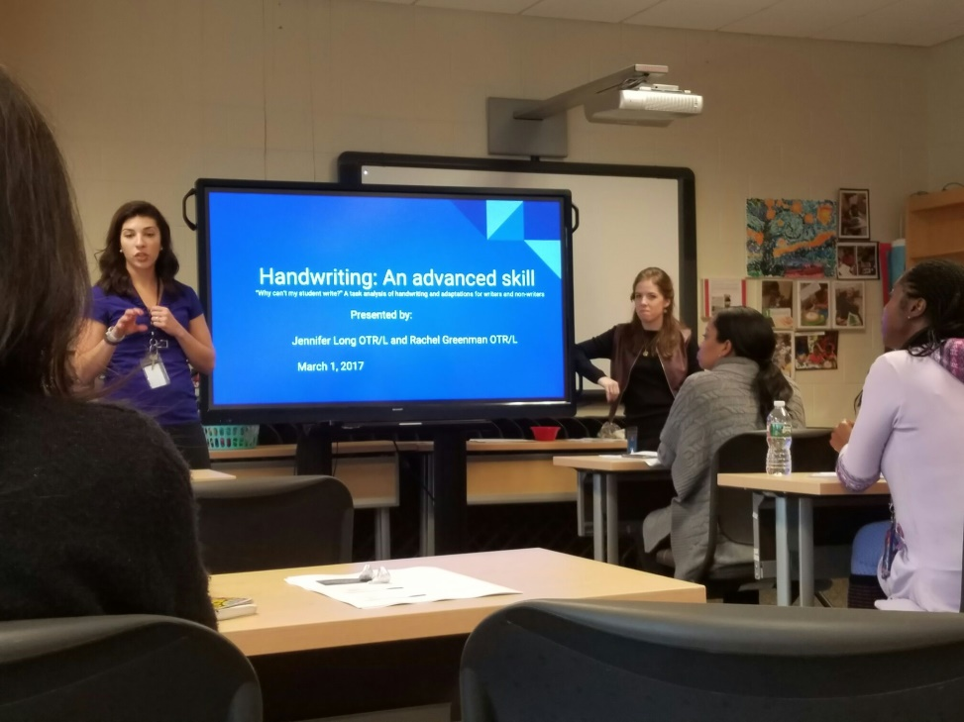
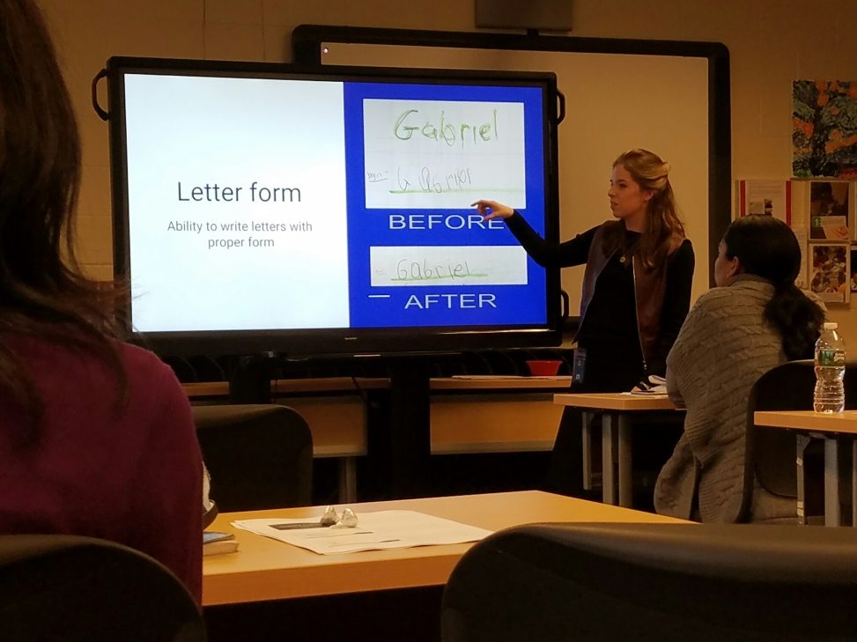
"Why Can't My Student Write? A task analysis of Handwriting and adaptations for writers and non-writers". Jennifer and Rachel’s In- Service at Center for Lifelong Learning began with an introduction of important developmental milestones that are necessary for pre-writing skills, from crawling (important for neck/core strengthening, proximal stability at the shoulder joint, and weight bearing, as well as reciprocal movements), to the development of fine motor skills. They discussed the important components that must be present for pre-handwriting, including proprioception, cognition, and vision (visual motor and visual perceptual skills). After staff had the basic understanding of the complexities of handwriting, they moved onto adaptations for both writers and non-writers. Jennifer and Rachel presented to the staff different fine motor activities for their classrooms, as well as different types of pencils, pencil grips and slant boards. They also spoke about the prerequisites for typing for students who do not write.

