Slide 1
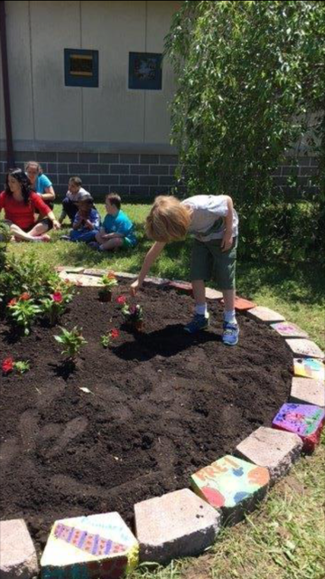
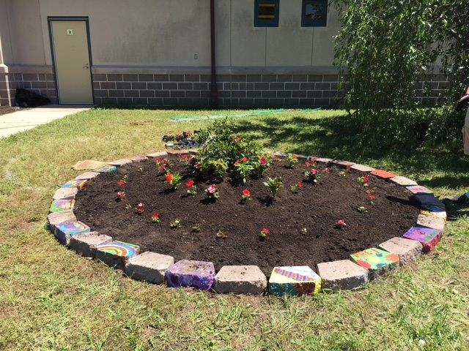
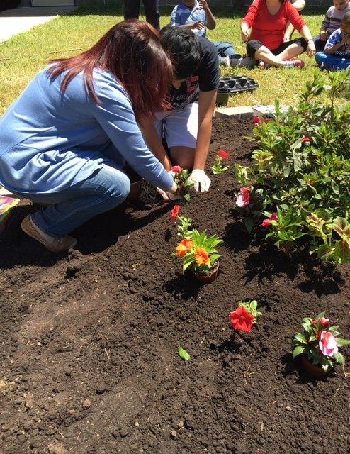
ALC – “Planting The Seeds of Independence” Garden Program The students of the Academy Learning Center created a beautiful flower garden on the campus grounds for all to enjoy. The students initially worked together to paint a garden stone to represent each and every class at ALC. Together, these beautiful painted pavers formed the outline of their garden; which was plotted out, planted, watered and maintained by various students over the course of many months. Through this project, the students learned how to plant, care for and enjoy the many fragrant flowers that grew throughout the summer and fall. This coming spring, the students will be working to turn-over the garden and prepare it for new growth. We are all looking forward to watching their skills and accomplishments grow right along with their garden.

